Slide 1
CPE 656
Software Engineering Studio I
Train Location Project
University of Alabama in Huntsville
October 19, 2015
Stephen Jalbert
Rashad Madyun
Corey Sanders

Slide 2
WORK PRODUCTS
Status
SRS: Drafted initial requirements. Added system overall description. Creating analysis models.

Slide 3
WORK PRODUCTS
Agenda (10/19 – 10/26)
ROM, Process Document , Configuration Management Document
  Await Feedback
SRS
  Continue Modeling of Requirements Analysis
Test plan
  Create template
SDD
  Create template

Slide 4
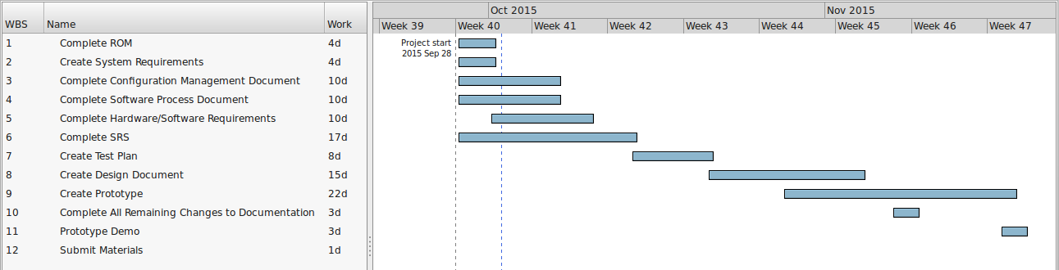
Schedule

